Slide 2
Operating System II CMP 321 Scheduling
Egena Onu, PhD.
Computer Science Department,
Bingham University.

Slide 3
Process Scheduling
Modern operating systems are multiprogramming operating systems.
A multiprogramming OS is one that allows more than one process to share the executable memory and CPU at the same time.
Process scheduling is an essential part of a multiprogramming operating systems.
Process scheduling is the action of the process manager that handles the removal of a running process from the CPU and the selection of another process on the basis of a particular strategy.

Slide 4
Category of Scheduling
There are two categories of scheduling:
Pre-emptive Scheduling:
Here the OS allocates the resources to a process for a fixed amount of time.
During resource allocation, the process switches from running state to ready state or from waiting state to ready state.
This switching occurs as the CPU may give priority to other processes and replace the process with higher priority with the running process.
Non-Pre-emptive Scheduling:
Here the resource can’t be taken from a process until the process completes execution.
The switching of resources occurs when the running process terminates and moves to a waiting state.

Slide 5
Process Scheduling Queue
The OS maintains the Process Control Blocks (PCB) in the Process Queue.
The OS also keeps a separate queue for each of the process states and PCBs of all processes in the same execution state are placed in the same queue.
When the state of a process is changed, its PCB is unlinked from its current queue and moved to its new state queue.
The OS maintains three important scheduling queues:
Job Queue
Ready Queue
Device Queue
Job Queue
Ready Queue
CPU
I/O
I/O/Waiting Queue

Slide 6
Process Scheduling Queue
Job Queue
The job queue maintains all process in the system.
Ready Queue
This queue maintains the set of process in the main memory at any one time, waiting and ready to execute.
Any new process is entered into this queue.
Device Queue
The processes which are blocked due to unavailability of an I/O device are contained in this queue.

Slide 7
Schedulers
Schedulers are special system software that handle process scheduling.
The task of a scheduler is to select the jobs to be submitted into the system and to decide which process to run.
There are three types of schedulers:
Long-Term Scheduler
Short-Term Scheduler
Medium-Term Scheduler

Slide 8
Schedulers
Long-Term Scheduler
The long-term scheduler determines which programs are admitted to the system for processing.
This scheduler selects processes from the queue and loads them into memory for execution.
On some systems, the long-term scheduler may not be available or minimal.
To change a process’ state from new to ready, the OS uses the long-term scheduler.
Notes:
Process loads into the memory for CPU scheduling.
The primary objective of the job scheduler is to provide a balanced mix of jobs, such as I/O bound and processor bound. It also controls the degree of multiprogramming. If the degree of multiprogramming is stable, then the average rate of process creation must be equal to the average departure rate of processes leaving the system.
Time-sharing operating systems have no long term scheduler.

Slide 9
Schedulers
Short-Term Scheduler
The short-term scheduler is also referred to as the CPU scheduler.
The short-term scheduler is used to increase system.
It effects the change of ready state to running state of a process.
The CPU scheduler selects a process among the processes that are ready to execute and allocates CPU to one of the
Short-term schedulers, also known as dispatchers, make the decision of which process to execute next.
Short-term schedulers are faster than long-term schedulers. m.

Slide 10
Schedulers
Medium-Term Scheduler
Medium-term scheduler is used for the swapping of processes.
It removes the processes from the memory thereby reducing the degree of multiprogramming.
It is in-charge of handling the swapped out-processes.
Notes:
A running process may become suspended if it makes an I/O request. A suspended processes cannot make any progress towards completion. In this condition, to remove the process from memory and make space for other processes, the suspended process is moved to the secondary storage. This process is called swapping, and the process is said to be swapped out or rolled out. Swapping may be necessary to improve the process mix.

Slide 11
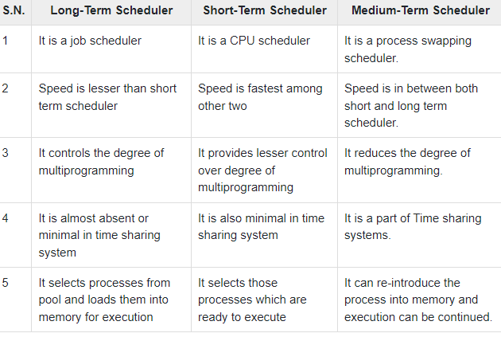
Comparing Schedulers

Slide 12
Scheduling Algorithm
In scheduling, a CPU scheduler selects one of the ready processes and allocates the CPU to it.
There are a number of occasions when we can/must choose a new process to run:
A running process blocks (running ! blocked).
A timer expires (running ! ready).
A waiting process unblocks (blocked ! ready).
A process terminates (running ! exit).

Slide 13
Scheduling Criteria
A variety of metrics may be used:
CPU Utilization: the fraction of the time the CPU is being used (and not for idle process!).
Throughput: # of processes that complete their execution per time unit.
Turnaround Time: amount of time to execute a particular process.
Waiting Time: amount of time a process has been waiting in the ready queue.
Response Time: amount of time it takes from when a request was submitted until the first response is produced (in time-sharing systems)

Slide 14
Scheduling Strategy
Sensible scheduling strategies might be:
Maximize throughput or CPU utilization.
Minimize average turnaround time, waiting time or response time.
Also there is need to worry about fairness and liveness.

Slide 15
Scheduling Algorithm
A Process Scheduler schedules different processes to be assigned to the CPU based on particular scheduling algorithms.
There are six popular process scheduling algorithms:
First-Come, First-Served (FCFS) Scheduling
Shortest-Job-Next (SJN) Scheduling
Priority Scheduling
Shortest Remaining Time
Round Robin(RR) Scheduling
Multiple-Level Queues Scheduling

Slide 16
First-Come, First-Served (FCFS) Scheduling
Jobs are executed on first come, first serve basis.
It is a non-preemptive, pre-emptive scheduling algorithm.
Easy to understand and implement.
Its implementation is based on FIFO queue.
Poor in performance as average wait time is high.

Slide 17



First-Come, First-Served (FCFS) Scheduling
FCFS depends on order processes arrive, e.g., given three processes $P_{1}$, $P_{2}$ and $P_{3}$.
If processes arrive in the order $P_{1}$, $P_{2}$, $P_{3}$.
In this case:
Waiting time for $P_{1}=0$; $P_{2}=25$; $P_{3}=29$.
Average waiting time: (0+25+29)/3 = 6.

Slide 18


First-Come, First-Served (FCFS) Scheduling
If processes arrived in the order: $P_{3}$, $P_{2}$, $P_{1}$:
Waiting time for: $P_{1}=11$; $P_{2}=7$; $P_{3}=0$.
Average waiting time is: (11+7+0)/3 = 6.

Slide 19
Shortest-Job-Next (SJN) Scheduling
SJN is a hybrid scheduling algorithm because it is both a preemptive and non-preemptive scheduling algorithm.
It presents the best approach to minimize waiting time.
It is easy to implement in Batch systems where required CPU time is known in advance.
It is however impossible to implement in interactive systems where required CPU time is not known.
The processer should know in advance how much time process will take.

Slide 20
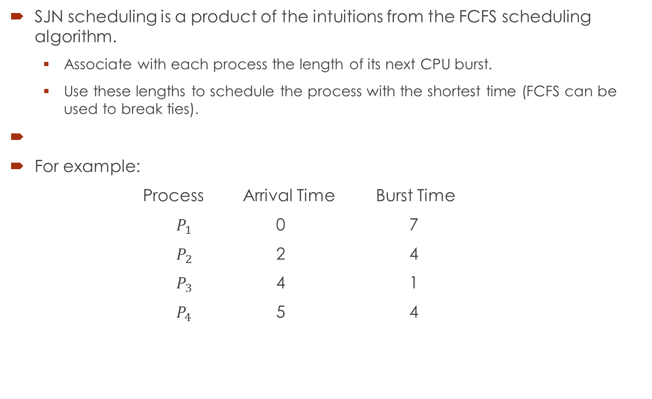
Shortest-Job-Next (SJN) Scheduling
SJN scheduling is a product of the intuitions from the FCFS scheduling algorithm.
Associate with each process the length of its next CPU burst.
Use these lengths to schedule the process with the shortest time (FCFS can be used to break ties).
For example:
Process Arrival Time Burst Time
$P_{1}$ 0 7
$P_{2}$ 2 4
$P_{3}$ 4 1
$P_{4}$ 5 4

Slide 21


Shortest-Job-Next (SJN) Scheduling
Given the process queue:
The waiting time for: $P_{1}=0$; $P_{2}=6$; $P_{3}=3$; $P_{4}=7$;
The average waiting time is: (0+6+3+7)/4 = 4.
SJN is an optimal scheduler because it gives the minimum average waiting time for any given set of process.

Slide 22
Priority Scheduling
Priority scheduling is a non-preemptive algorithm and one of the most common scheduling algorithms in batch systems.
Each process is assigned a priority. The Process with the highest priority will be executed first.
Processes with the same priority are executed on first come first served basis.
The parameters that determine priority are: memory requirements, time requirements or any other resource requirement.
There are two types of priority scheduling: static and dynamic priority scheduling.

Slide 23
Priority Scheduling
Static Priority Scheduling:
This algorithm associates an integer priority with each process. E.g.,
Priority Type Priority Type
0 System internal process es 2 Interactive processes
1 Interactive processes 3 Batch processes
Static priority scheduler then allocate the CPU to the highest priority process.
The process with the smaller integer is considered the higher priority process.
Notes:
Example of Interactive process: students, staff, customers

Slide 24
Priority Scheduling
Dynamic Priority Scheduling

Slide 25

Shortest Remaining Time First (SRTF)
SRTF is the preemptive version of SJN.
In SRTF, if new process arrives with a CPU burst length less than the remaining time of the current executing process, preempt.
For example:
Process Arrival Time Burst Time
$P_{1}$ 0 7
$P_{2}$ 2 4
$P_{3}$ 4 1
$P_{4}$ 5 4

Slide 26


Shortest Remaining Time First (SRTF)
The waiting time for: $P_{1}=9$; $P_{2}=1$; $P_{3}=0$; $P_{4}=2$;
Average waiting time: (9+1+0+2)/4 = 3.

Slide 27
Round Robin(RR) Scheduling
RR defines a small fixed unit of time called a quantum (or time-slice), typically 10-100 milliseconds. Then:
Process at head of the ready queue is allocated the CPU for (up to) one quantum.
When the time has elapsed, the process is preempted and added to the tail of theready queue.

Slide 28
Round Robin(RR) Scheduling
Round robin has some nice properties:
Fair: if there are n processes in the ready queue and the time quantum is q, then each process gets 1/nth of the CPU.
Live: no process waits more than (n − 1)q time units before receiving a CPU allocation.
RR typically gets higher average turnaround time than SRTF, but better average response time.
It is quite tricky choosing the correct size of the quantum, therefore, if:
q too large ) FCFS/FIFO
q too small ) context switch overhead too high.

Slide 29
Dispatch and Context Switching

Slide 30
Questions!!!

